Slide 1
Representing Images
LO: understand how bitmapped and vector images are represented in a computer

Slide 2
Representing Images
LO: understand how bitmapped and vector images are represented in a computer
Specification Points
3.5.6 Representing images, sound and other data

Slide 3
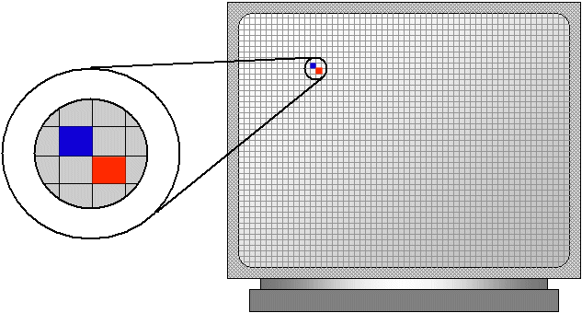
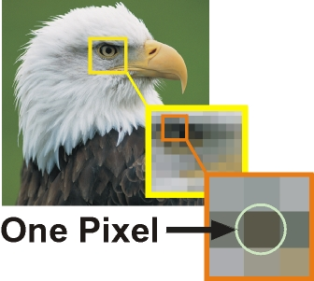
Representing Images
LO: understand how bitmapped and vector images are represented in a computer
Bitmapped Graphics
The display on a monitor is made up of thousands of tiny dots or picture elements called pixels.
A typical monitor might have a grid of 1366 by 768 pixels.
This is known as the resolution.

Slide 4
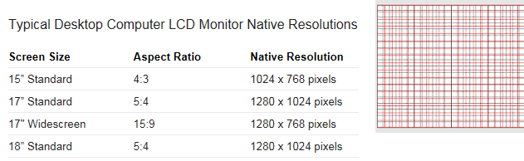
Representing Images
LO: understand how bitmapped and vector images are represented in a computer
Bitmapped Graphics
LCD screens have a ‘native resolution’ which is the number of pixels it is made up of (width x height)
A LCD can’t display a resolution greater than it’s native resolution – it has no way of representing more pixels.

Slide 5
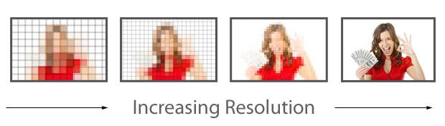
Representing Images
LO: understand how bitmapped and vector images are represented in a computer
Bitmapped Graphics
This term is also used on individual picture files. So the resolution of a file in pixels is:
Resolution = Width × Height
By combining the pixels, a picture is created on the screen.
The greater the resolution of an image the more pixels are used to display it which means the image is represented more precisely

Slide 6
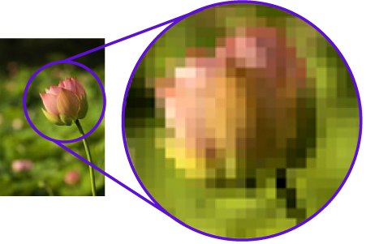
Representing Images
LO: understand how bitmapped and vector images are represented in a computer
Bitmapped Graphics
At a very simple level, each pixel could be controlled by one bit.
This means that each pixel is mapped to one bit in memory.
The bit could be set to either 0 or 1 representing off or on which in this case would be black or white.
To create colour graphics, each pixel could be mapped to at least one byte (eight bits) in memory.

Slide 7
Representing Images
LO: understand how bitmapped and vector images are represented in a computer
Bitmapped Graphics
Meta Data – data stored about an image e.g. it’s resolution
Resolution – width and height of an image
Colour Depth – the number of bits used to represent each pixel

Slide 8
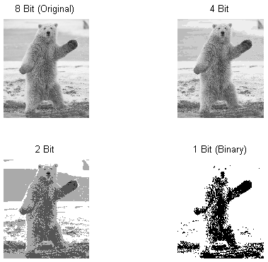
Representing Images
LO: understand how bitmapped and vector images are represented in a computer
Bitmap Questions
How many colours can be represented when using:
2 bit colour depth?
1 bit colour depth?
8 bit colour depth?
What is the advantage of a low colour depth?

Slide 9
Representing Images
LO: understand how bitmapped and vector images are represented in a computer
Bitmap and Vector Research
Find 3 bitmap file types
Find 3 programs that allow users to create vector graphics
How are colours represented using the RGB colour system?
Write an explanation of this in your exercise books

Slide 10
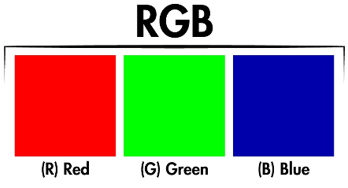
Representing Images
LO: understand how bitmapped and vector images are represented in a computer
Bitmap and Memory
The amount of memory allocated for bit-mapping depends on the amount of memory on the graphics card.
Storage = Resolution × colour depth
If 24 bits were allocated to each pixel this would give 2²⁴ combinations or 16 777 216 different colours.
24 bits are typically used as eight bits are allocated to each of the three primary colours, red, green and blue (RGB), from which all other colours are created.
This means that, with a 1024 × 768 display with 24 bits per pixel, you get 18 874 368 bits or 2.36 Mb of memory to make one picture.

Slide 11
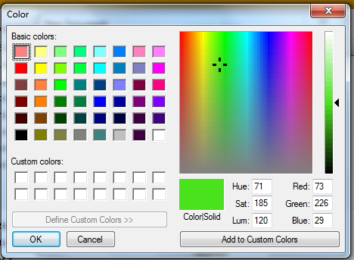
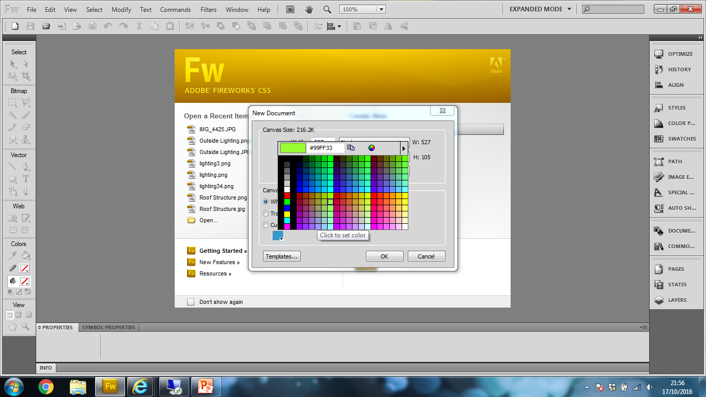
Representing Images
LO: understand how bitmapped and vector images are represented in a computer
RGB Colour Scheme
8 bits for the Red value
8 bits for the Green value
8 bits for the Blue value
Commonly represented in Hexadecimal

Slide 12
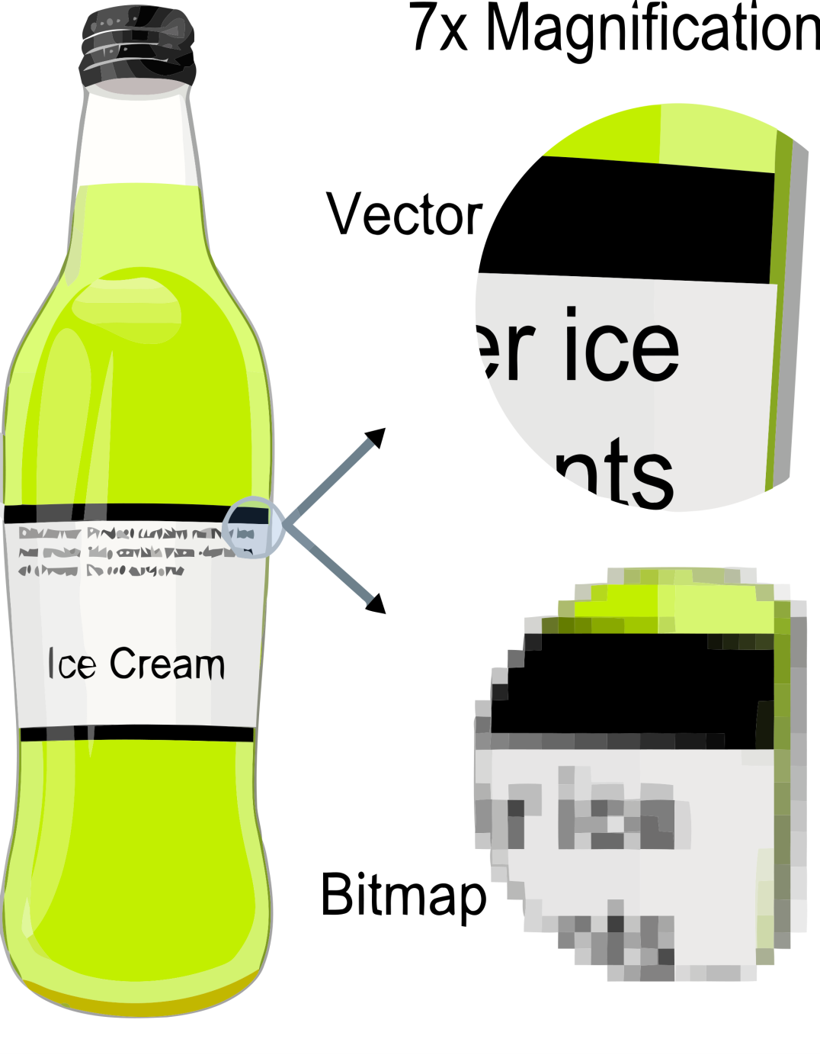
Representing Images
LO: understand how bitmapped and vector images are represented in a computer
Vector Graphics
Vector graphics are created using objects and coordinates.
A vector is a measure of quantity and direction.
It is easier to think of vector graphics as geometric shapes.
For example, if we had a vector graphic of a square it would be made up of four coordinates with lines drawn between them.
Vector images are made up of primitives, which are the basic pieces of data needed to create an image. Typically this will be points, lines, curves and polygons.

Slide 13
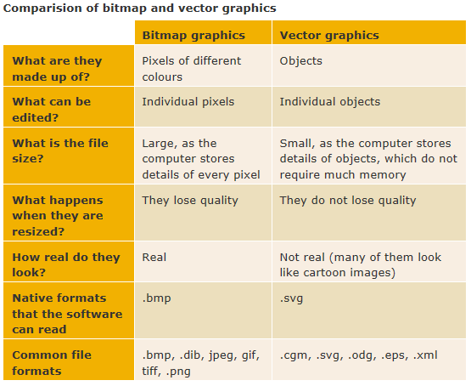
Representing Images
LO: understand how bitmapped and vector images are represented in a computer

Slide 14
Representing Images
LO: understand how bitmapped and vector images are represented in a computer
Prep: Digital Cameras
How a digital camera works
https://www.youtube.com/watch?v=E_OsK5_sElA
https://www.youtube.com/watch?v=kwsulxODrqo

Slide 15
Representing Images
LO: understand how bitmapped and vector images are represented in a computer
Prep: Digital Cameras
Watch the two videos on the previous slide and draw a flow chart to describe the process of a digital camera capturing an image.

Slide 16
Representing Images
LO: understand how bitmapped and vector images are represented in a computer
Explain in detail how digital cameras capture an image.
When a photograph is taken, the shutter opens and lets light in through the lens.
The light is focussed onto a sensor, which is usually either a charge coupled device (CCD) or a complementary metal oxide semiconductor (CMOS).
The sensors are made up of millions of transistors, each of which stores the data for one or more pixels.
A pixel is a picture element or individual dot, where the whole image will be made up of millions of pixels.
As the light hits the sensor, it is converted into electrons and the amount of charge is recorded for each pixel in digital form. The greater the intensity of light, the greater the charge.
To record colour, the camera will either have three different sensors, or use three different filters – one for red, one for green and one for blue.
The data are typically stored onto removable storage devices such as an SD card
Data are usually stored in compressed files, for example, TIFF, JPG or PNG.
RAW files can also be generated, which are uncompressed and therefore contain all of the data from the original photograph.
This digital data can now be decoded and manipulated using specialised software.

Slide 17
Add file compression to this lesson

Slide 18





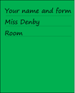









Key words:
Noted clearly
Topic specific vocabulary wherever necessary
Icon for extension activity if appropriate
Icon same colour as dept ex book
You might want to develop subject specific icons

